Slide 1



INTELLIBIN ADVANCED IOT-ENABLED SMART WASTE MANAGEMENT SYSTEM
Presented By,
ABINAYA P (811722104003)
CHARUMATHI P (811722104024)
JANAANI SV (811722104059)
Guided By,
Mr. A.Malarmannan, M.E.,
DD/MM/YYYY

Slide 2
ABSTRACT
The Smart Dustbin uses sensors and IoT to enhance urban waste management. An ultrasonic sensor measures the waste level and shows the fill percentage on an LCD. When the bin is full, the lid locks, sensor activity stops, and an alert with the bin’s weight and GPS location is sent to authorities. A manual reset button allows waste collectors to reopen the lid and restart the system after emptying. During normal use, a motion sensor enables automatic, touchless lid opening. This system supports timely waste collection, reduces manual checks, and promotes cleaner surroundings through real-time monitoring.
DD/MM/YYYY

Slide 3
OBJECTIVE
To monitor and display the dustbin's fill level and percentage using sensors.
To stop sensor functions and keep the lid closed automatically when the bin is full.
To notify the authority with the fill status, weight, and GPS location of the bin.
To enable manual reset and lid opening through a button after waste collection.
To provide a touchless and hygienic disposal experience using motion detection.
DD/MM/YYYY

Slide 4
LITERATURE SURVEY
S.No. | Paper Title | Year | Remark
1 | A survey of smart dustbin systems using the IoT and deep learning | 2024 | Integration of IoT technology for real-timedatacollection,waste segregation,optimizedroute planning.
2 | SmartDustbinManagement Using IoT | 2023 | Implementation of NodeMCU board, ultrasonic sensor, and proximity sensors for waste level detection and alert system
3 | Intelligent Bins & Smart Waste Management Systems | 2020 | Utilize interconnected sensors and devices to monitor and manage waste levels
DD/MM/YYYY

Slide 5
LITERATURE SURVEY
S.No. | Paper Title | Year | Remark
4 | IoT Based Smart Garbage Monitoring System | 2019 | Introduced real-time monitoring and alert system
5 | Smart Waste Management System using IoT and Machine Learning | 2020 | Added predictive waste analysis using ML algorithms
6 | AI-enabled Smart Dustbin for Clean Environmen | 2024 | Integrated AI for image-based waste classification
DD/MM/YYYY

Slide 6
LITERATURE SURVEY
S.No. | Paper Title | Year | Remark
7 | Smart Dustbin with Firebase Integration for Real-time Database Logging | 2025 | Implemented cloud storage and app notifications
8 | Smart Dustbin Using Arduino and Ultrasonic Sensor | 2018 | Basic prototype using sensors to detect waste level
9 | Design and Implementation of a Smart Waste Bin | 2022 | Focused on energy efficiency and solar-powered operations
DD/MM/YYYY

Slide 7
EXISTING SYSTEM
An existing smart dustbin system integrates basic automation and alert features to improve hygiene and convenience. It uses a motion sensor to detect hand movement, enabling automatic lid opening and closing without physical contact. This touchless mechanism helps prevent the spread of germs and enhances user experience in public and private spaces.
Additionally, the system sends a simple notification—typically through a mobile app or SMS—whenever the lid is opened. This can be used for usage tracking or basic maintenance alerts, ensuring that authorities or owners are aware of bin activity without the need for manual inspection.

Slide 8
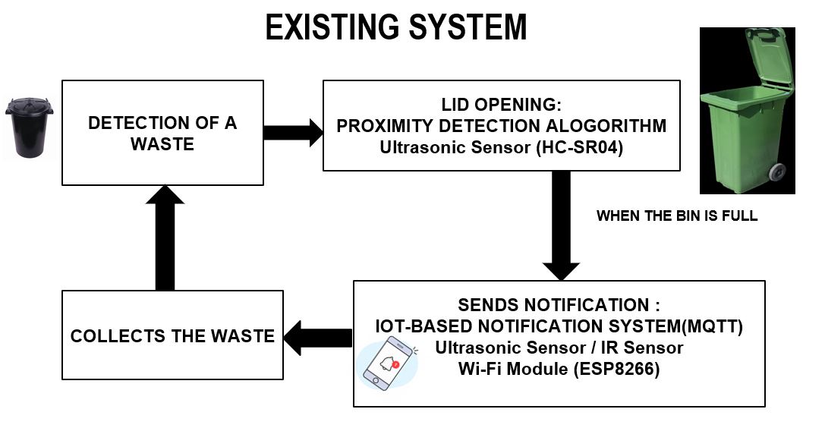
EXISTING SYSTEM
DD/MM/YYYY

Slide 9
PROPOSED SYSTEM
Automatic lid opening and closing using a motion sensor
Waste level detection using an ultrasonic sensor
Fill percentage display on an LCD screen
Automatic lid locking when the bin is full
Stopping of sensor activity when full
Real-time alert/notification sent to authorities
Notification includes bin weight and GPS location
Manual reset button for collectors after emptying

Slide 10
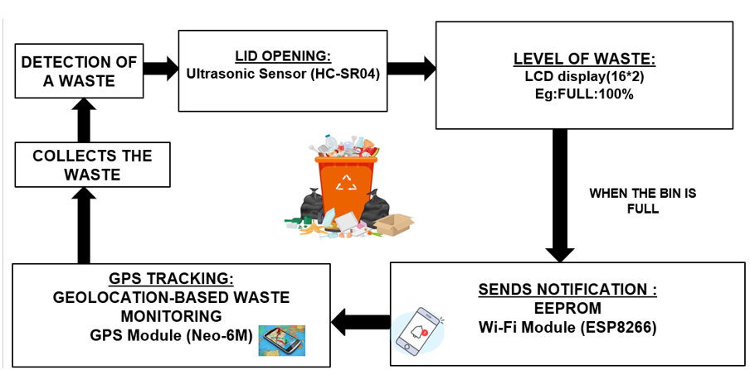
PROPOSED SYSTEM
DD/MM/YYYY

Slide 11
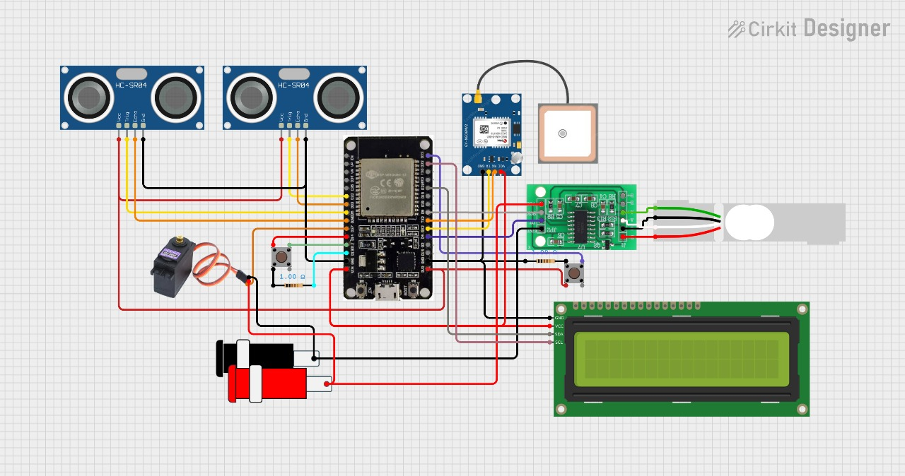
SYSTEM ARCHITECTURE
DD/MM/YYYY

Slide 12
MODULE 1 : Central Control Unit
Component: NodeMCU (ESP8266 / ESP32)
Function:
Acts as the brain of the system.
Collects and processes data from all sensors and modules.
Controls actuators (like servo motor).
Manages communication and decision-making.
DD/MM/YYYY

Slide 13
MODULE 2 :Waste Level Detection
Component: Ultrasonic Sensor (e.g., HC-SR04)
Function:
Measures the distance from the top of the bin to the trash.
Determines how full the bin is and sends the data to the NodeMCU.
DD/MM/YYYY

Slide 14
MODULE 3 : Automatic Lid Control
Component: Servo Motor
Function:
Automatically opens or closes the dustbin lid.
Triggered by proximity or waste level signals processed by the NodeMCU.
DD/MM/YYYY

Slide 15
MODULE 4 : Status Display and Reset
Components:
LCD Display – Shows current waste level or bin status
Push Button – Manual reset
Function:
Provides user interface for local monitoring and manual control.
DD/MM/YYYY

Slide 16
MODULE 5 : Communication and Tracking
Components:
GPS Module – Tracks and provides real-time location of the dustbin.
Wi-Fi or GSM Module – Sends alerts/notifications to the user (e.g., bin full, location).
Function:
Enables remote monitoring and tracking of mobile/field dustbins.
DD/MM/YYYY

Slide 17
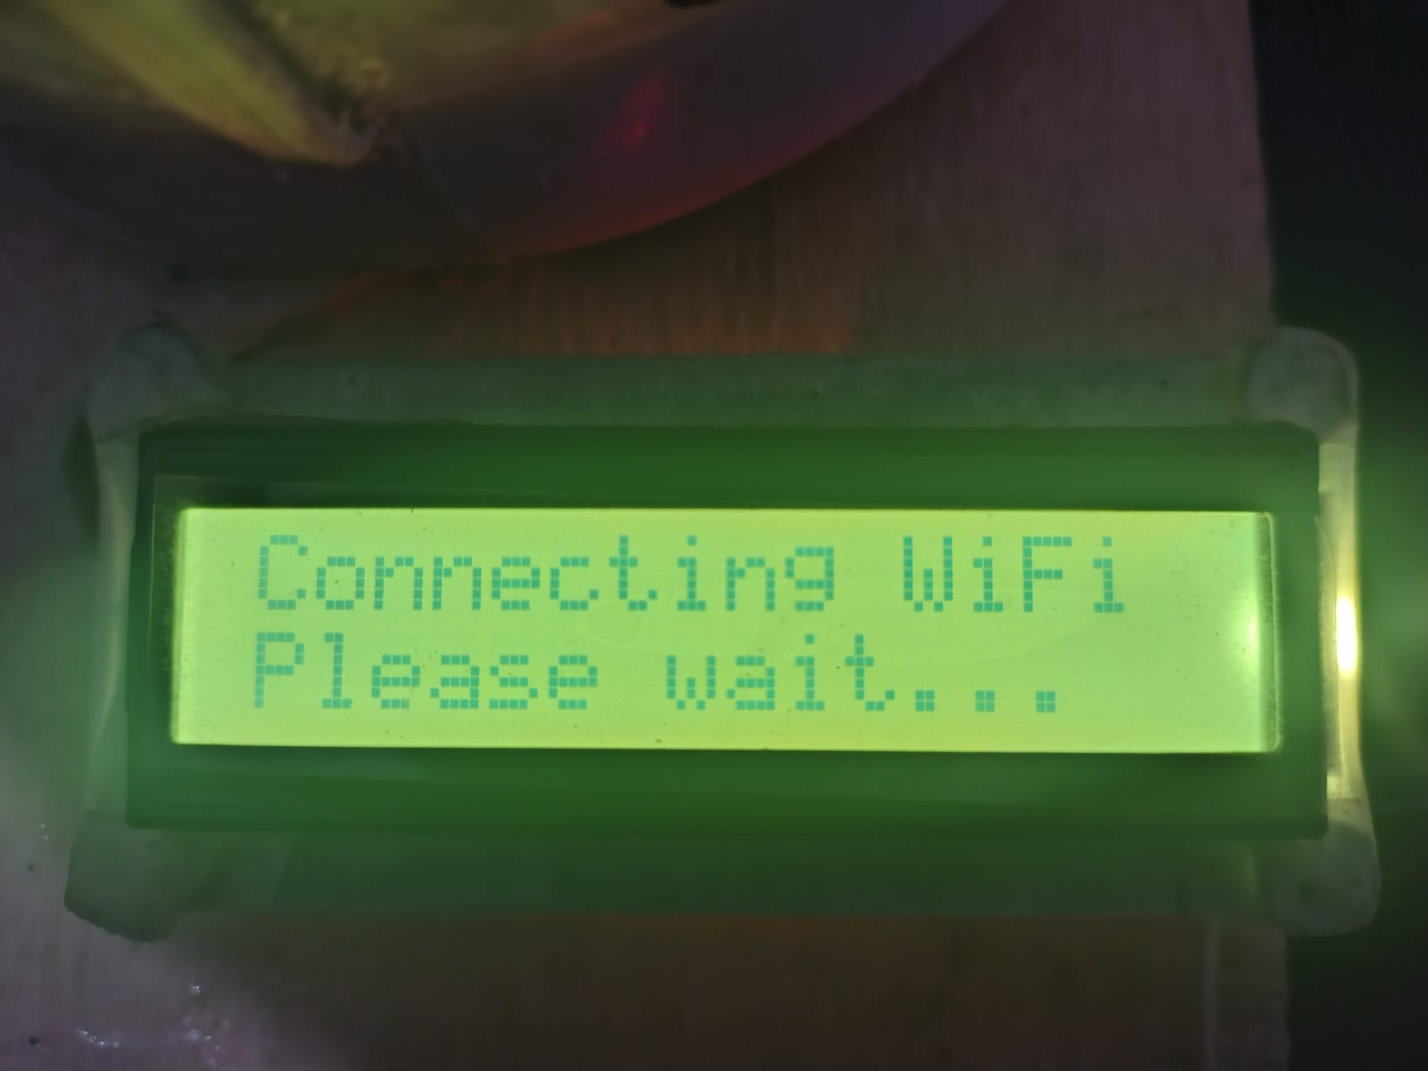
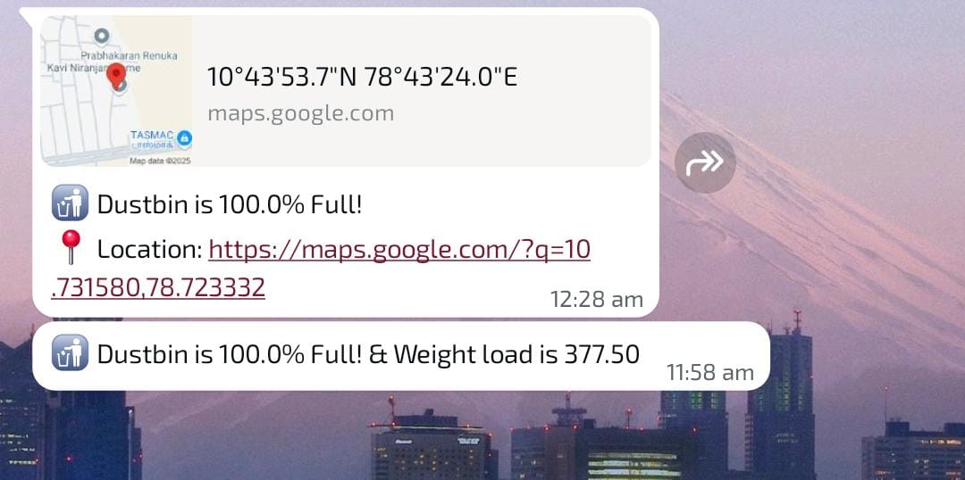
OUTPUT
DD/MM/YYYY

Slide 18
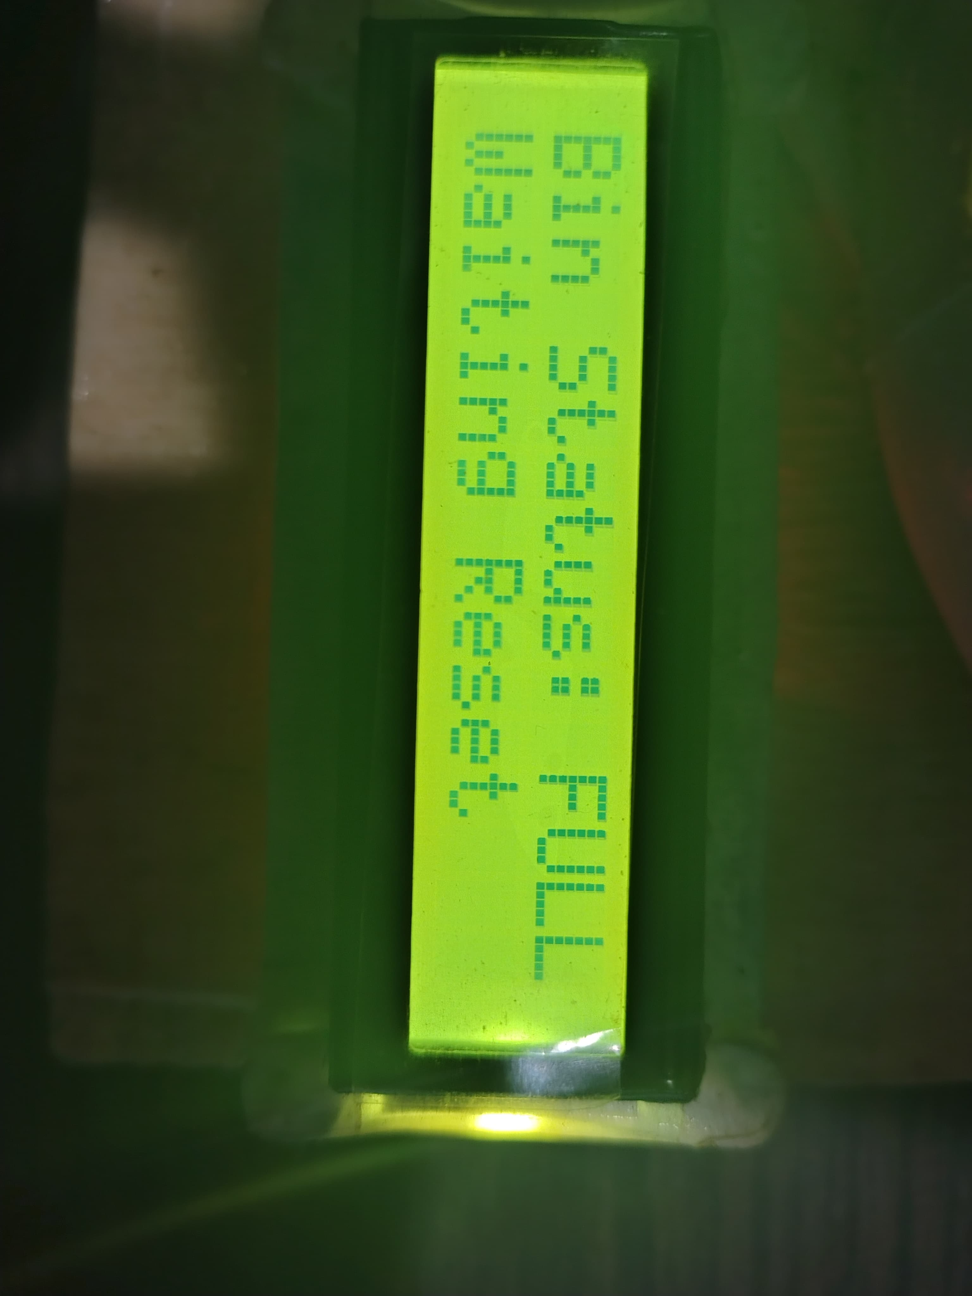
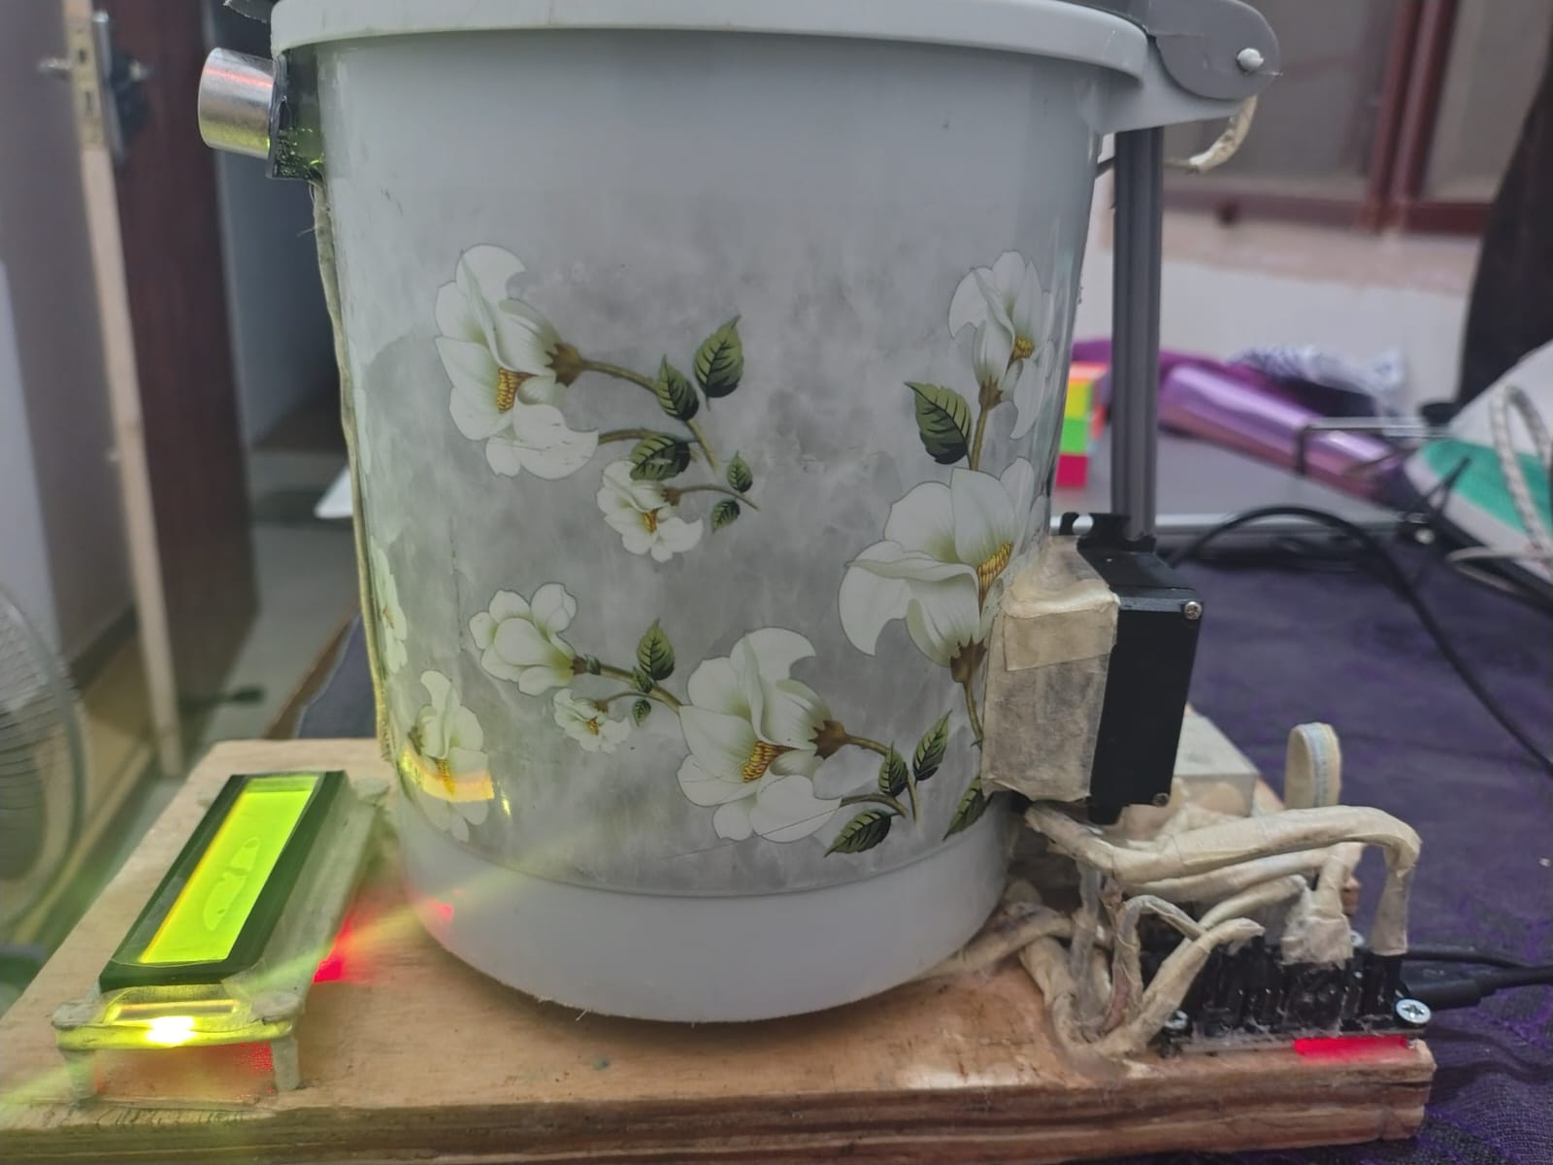
OUTPUT
DD/MM/YYYY

Slide 19
CONCLUSION & FUTURE ENHANCEMENT
The Smart Dustbin project introduces a technologically advanced approach to urban waste management by integrating automation and IoT capabilities. Using ultrasonic sensors, the system monitors the fill level in real time, displaying waste status on an LCD screen to prevent overflow and maintain cleanliness. When the dustbin reaches full capacity, the lid automatically closes, halting all sensor operations until it is manually reset by waste collectors. The inclusion of a motion sensor enables touchless waste disposal, enhancing hygiene and convenience in high-traffic areas. Furthermore, the system's alert mechanism sends real-time notifications to authorities, providing crucial details such as waste weight measured via a load cell and precise GPS location, allowing optimized collection routes for efficiency.
DD/MM/YYYY

Slide 20
REFERENCES
Kulkarni, R. R., Kumar, R., & Mehta, S. (2024). Smart Dustbin for Household Using Internet of Things (IoT). Journal of Green Engineering.
Narya, R. K., Sharma, P., & Gupta, A. (2024). Design and Implementation of a Smart Dustbin System Integrated with Solar Panel for Sustainable Waste Management. Journal of Alternate Energy Sources & Technologies.
Paul, L., Mohalder, R. D., & Alam, K. M. (2024). An IoT Based Smart Waste Management System for the Municipality or City Corporations. arXiv preprint.
Sumanth, G. B., Rao, T. K., & Aditi, R. (2023). Smart Dustbin Monitoring and Alert System Using IoT. International Journal for Research Trends and Innovation.
Shah, D., Patel, D., & Suthar, S. (2023). IoT Based Smart Dustbin. International Journal of Innovative Research in Science, Engineering and Technology.
DD/MM/YYYY

Slide 21

DD/MM/YYYY

